Slide 1
Annual Progress Review - Luke McGuinness
Title: Investigating the effect of blood lipids levels, and interventions that modify blood lipid levels, on dementia outcomes.
Start date: 1/1/2019
Expected submission date: 1/1/2022
Max submission date: 1/1/2023

Slide 2
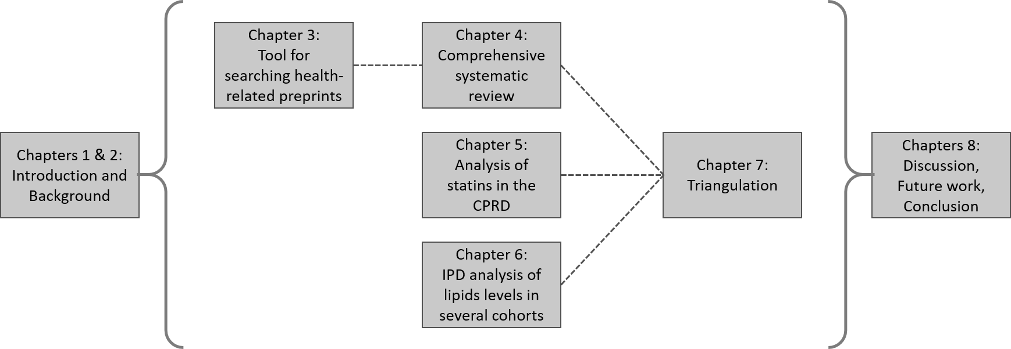
Thesis overview
*

Slide 3
Chapter 1&2 - Introduction and Background
Chapters 1 & 2 will likely be presented as a single chapter:
Aim and objectives at end following description of problem
Allows a better flow into Chapter 3
This chapter covers:
Introduction to topics (dementia, lipids, lipid regulating agents)
Introduction to the central aim and theoretical framework of thesis and challenges in current approaches
Overview of chapters
Progress: ~70%

Slide 4
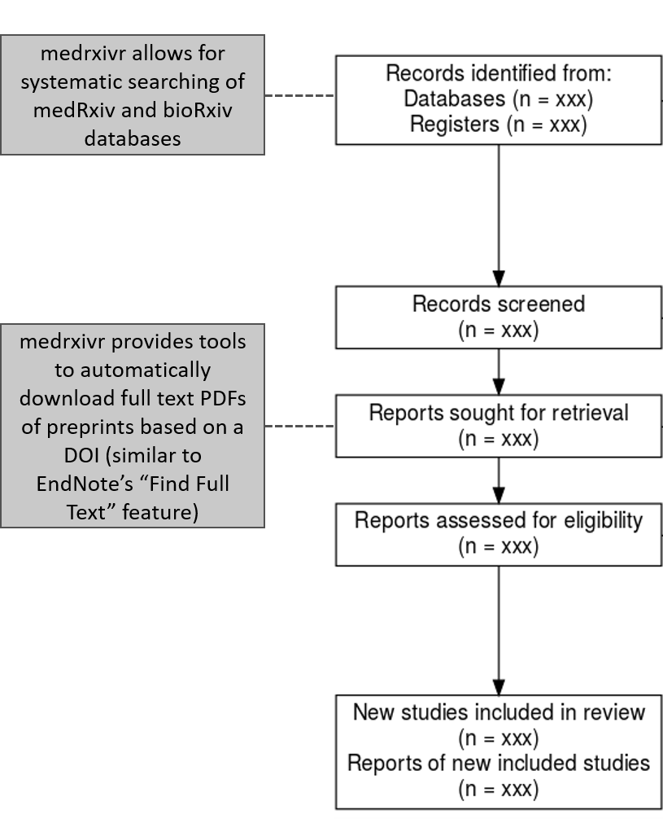
Chapter 3 – medrxivr preprint search tool
Previously, searches of health-related preprints were time-consuming and were not systematic/reproducible.
R package born from collection of scripts developed for search in Chapter 4.
Progress
Chapter: 100%
Paper: 100% (published)

Slide 5
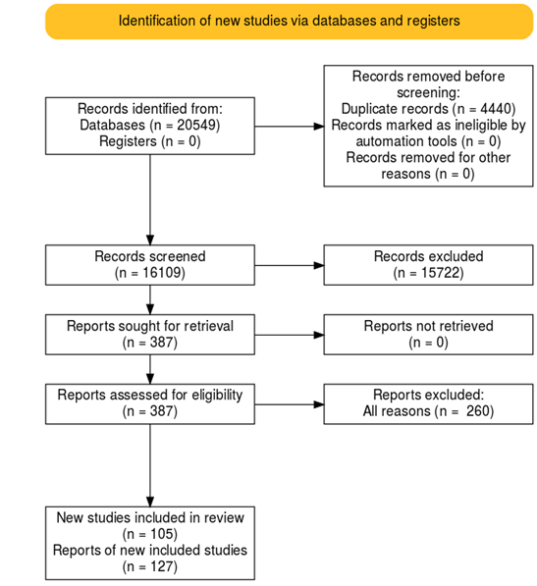
Chapter 4 – Comprehensive systematic review
Review of all available evidence on effect of blood lipids, and factors that affect blood lipids, on dementia outcomes.
Added value
Risk-of-bias assessments
Searching and including preprints (for MR)
Progress
Analysis: 80%
Chapter: 70%
Paper: 80%

Slide 6
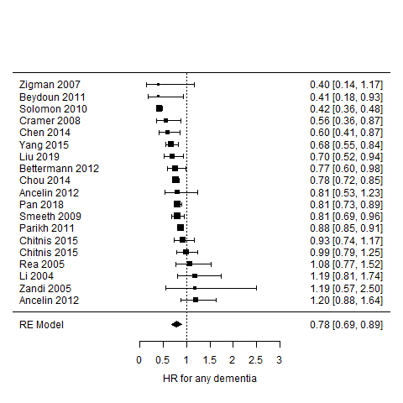
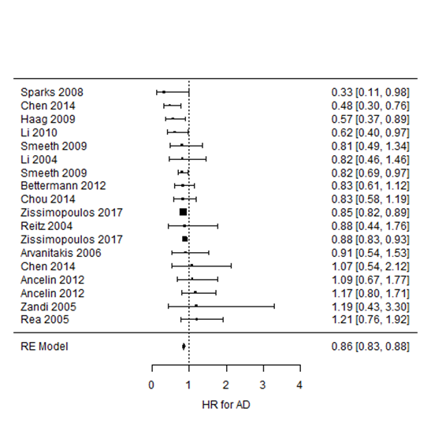
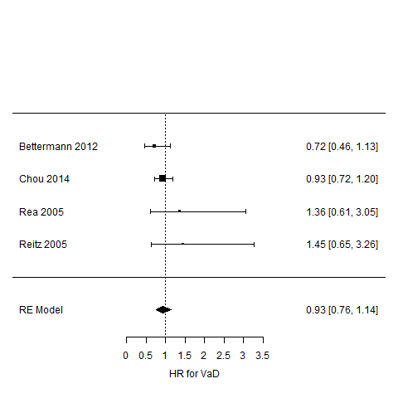
Ch4 Results: Statins on dementia outcomes
Dementia : 0.78 (0.69-0.89)
AD: 0.86 (0.83-0.88)
VaD: 0.93 (0.76-1.14)

Slide 7
Ch4 To do:
Finish analysis of non-intervention studies
Complicated by different measures of lipids
Finish risk-of-bias assessments
85% complete
Include some assessment of predicted direction and magnitude of bias
Write-up chapter and associated paper

Slide 8
Chapter 5 – CPRD analysis of statins -> dementia
Analysis of the effect of statins, using a Cox PH model with a time-varying treatment indicator
Added value
Size and length of follow-up
Provides evidence with different sources of bias
Progress
Chapter: 80%
Paper: 80%

Slide 9
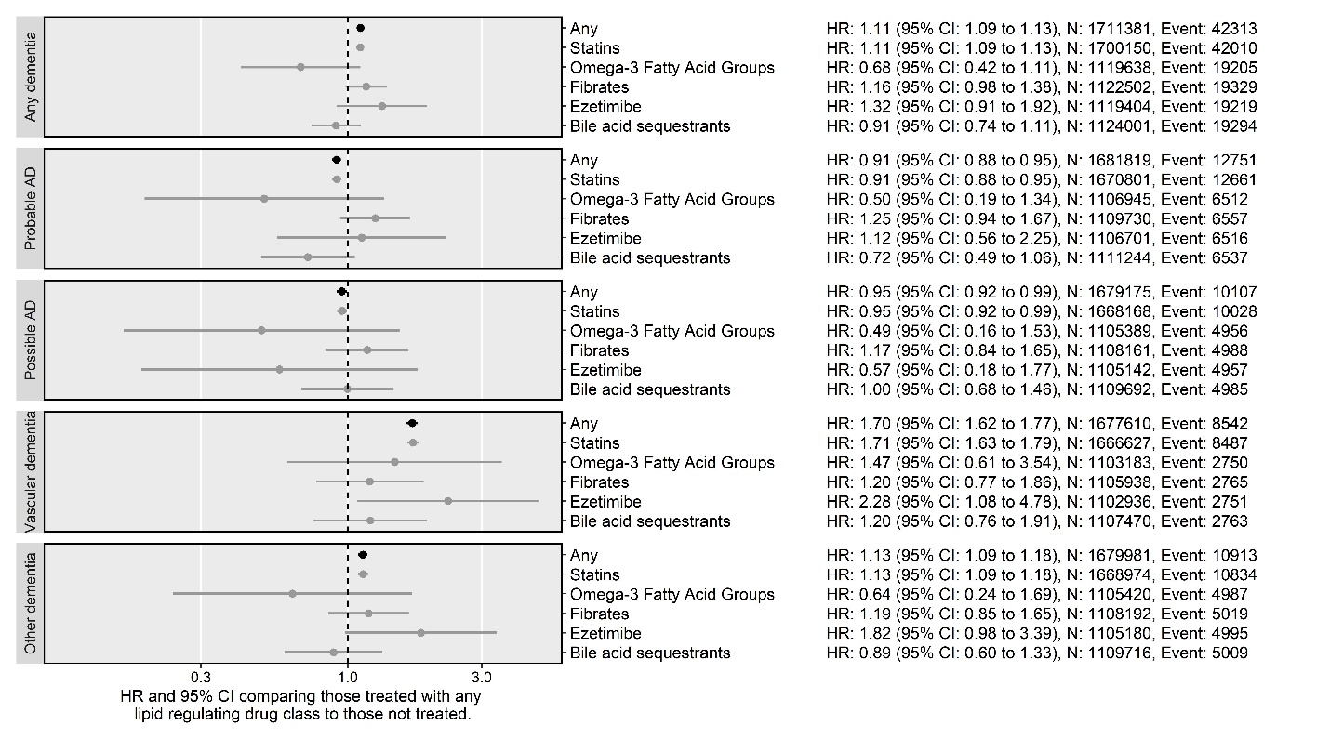
Challenges with analysis
Analysis found harmful effect of statins for VaD, and outcomes with high case mix of VaD (e.g. all-cause and other dementia)
Using a known control of coronary heart disease also gives harmful effect of statins, suggesting substantial confounding by indication
Have tried:
Selecting cohort using QRisk score rather than lipid tests as index event
Multiple imputation to avoid complete case bias
Adjusting for additional covariates (very little effect after adjusting for age)
Replication other analysis strategies (e.g. Smeeth 2010)

Slide 10
Chapter 6 – IPD analysis
Analysis not yet started, though have access to several cohorts in the DPUK
Cohorts identified through the review in Chapter 4 have also been invited to participate

Slide 11
Chapter 7 – Triangulation
Only some exposure-outcome pairs will have sufficient forms of evidence to allow for this
A key example is effect of statins on all-cause dementia:
CPRD analysis: HR: 1.11 (1.09-1.06)
MA of observational studies: HR: 0.78 (0.69-0.89)
Randomised trial OR: 1.00 (0.60-1.65)
Mendelian randomization: RR: 0.90 (0.29-2.83)
RCT and MR agree – but observational data does not (confounding by indication/immortal time bias)

Slide 12
Chapter 7 – Triangulation
Most published examples are qualitative (e.g. Study 1 found this, Study 2 found this)
Quantitative approaches:
Suggested to put together panel (e.g. Debbie Lawlor, Kate Tilling, George Davey Smith) and use their consensus to put priors on the amount and direction of bias they’d expect
Alternatively, use a measure like the “E value” to provide quantitative strength of unmeasured confounders and see if this is likely
Would be great to hear what you would expect this to look like (e.g. qualitative/quantitative)

Slide 13
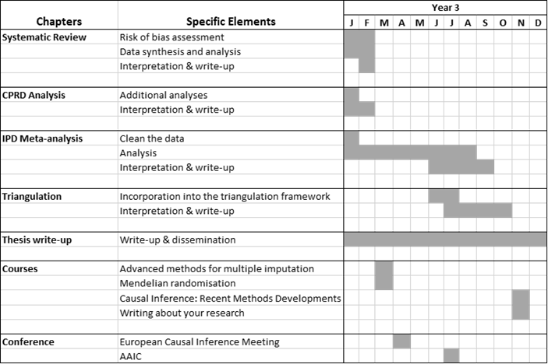
Planned progress

Slide 14
Training and development
Training
All planned courses cancelled last year.
Coming year:
Mendelian randomisation short course (Bristol: place booked)
Advanced methods for multiple imputation (Bristol: place booked)
New methods in causal inference (LSHTM)
Writing about your research (Royal Society)
Presentations
Presented to Bristol MESS and Auto-synthesis seminars.
Co-organised Evidence Synthesis and Meta-analysis in R conference
Plan to present more of my other work this year:
Abstract submitted to AAIC
Presentation at IEU monthly meeting
Bristol PGR Showcase

Slide 15
Other work
Teaching
Several teaching roles:
MSc Epidemiology/Public Health “Clinical Epidemiology” module
“Intro to R” PhD short course
“Intro to Data Visualisation and Web Applications with R” short course
“Intro to R” open-door sessions
Other research
Three main areas of other research:
COVID-related reviews
Evidence synthesis tools (PRISMA2020, robvis)
Open science (review of DAS, commentary on synthesis-ready primary research)

